Slide 1
Spotify predictions
Dor Azaria
Egor Kononov​​

Slide 2

topics
Popularity Prediction
Mood Prediction (Happy, Sad, Romanic, Chill)

Slide 3
Reasons to predict
Popularity
Mood
Commercial
Financial
Musical
Therapy
Social Mental State

Slide 4
The dataset
Primary:
id (Id of track generated by Spotify)
Numerical:
acousticness (Ranges from 0 to 1)
danceability (Ranges from 0 to 1)
energy (Ranges from 0 to 1)
duration_ms (Integer typically ranging from 200k to 300k)
instrumentalness (Ranges from 0 to 1)
valence (Ranges from 0 to 1)
popularity (Ranges from 0 to 100)
tempo (Float typically ranging from 50 to 150)
liveness (Ranges from 0 to 1)
loudness (Float typically ranging from -60 to 0)
speechiness (Ranges from 0 to 1)
year (Ranges from 1921 to 2020)
Dummy:
mode (0 = Minor, 1 = Major)
explicit (0 = No explicit content, 1 = Explicit content)
Categorical:
key (All keys on octave encoded as values ranging from 0 to 11, starting on C as 0, C# as 1 and so on…)
artists (List of artists mentioned)
release_date (Date of release mostly in yyyy-mm-dd format, however precision of date may vary)
name (Name of the song)
Spotify Dataset 1921-2020, 160,000 Track

Slide 5
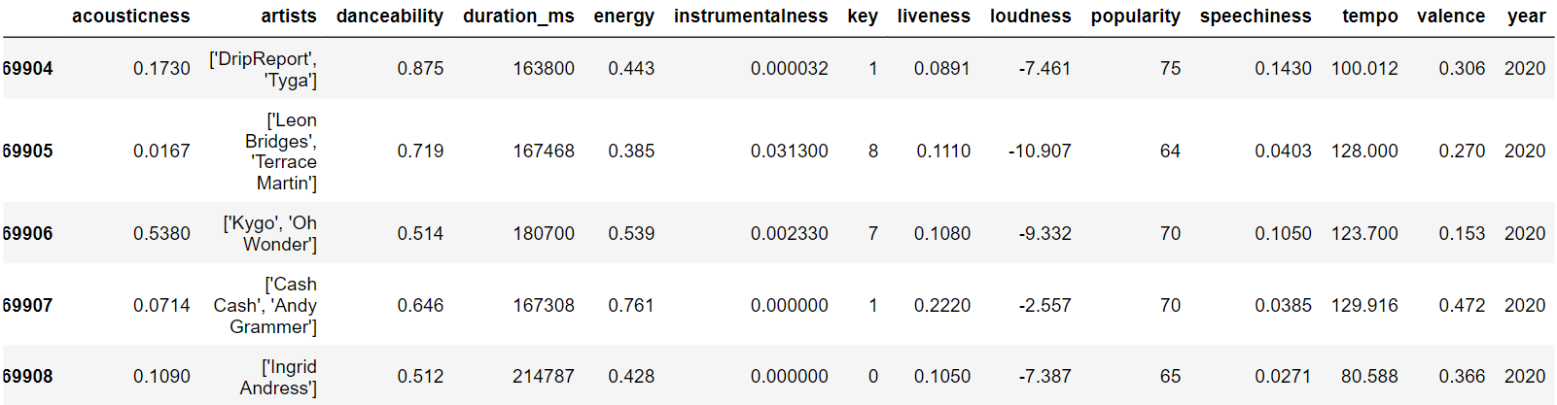
The dataset

Slide 6
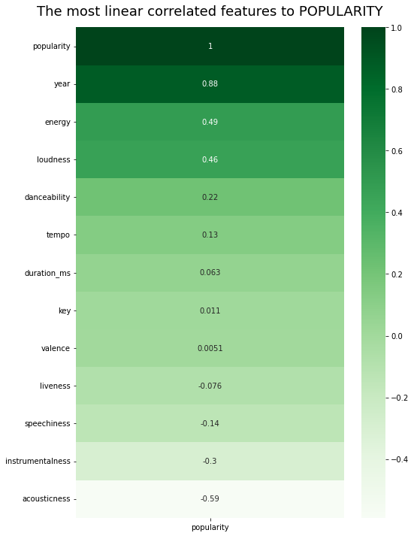
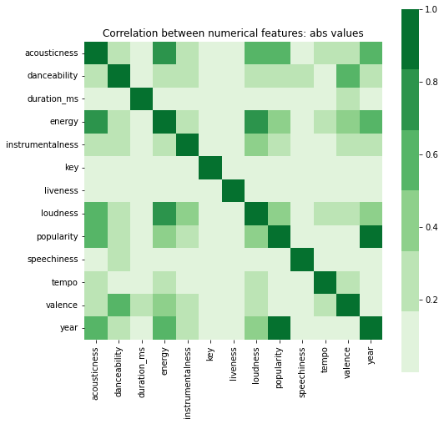
EDA – POPULARITY PREDICTION
At the beginning of the data analysis, we checked the correlations
MATRIX CORRELATION

Slide 7
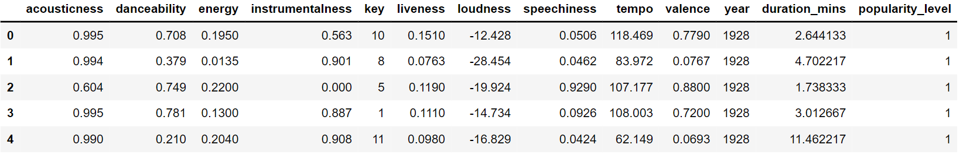

POPULARITY PREDICTION
Preparation
Acousticness
Danceability
Energy
Instrumentalness
Key
Liveness
Loudness
Speechiness
Tempo
Valence
Year
Duration in minutes
Popularity Range:
$0≤Popularity≤30→1$
$30<Popularity≤60→2$
$60<Popularity≤100→3$

Slide 8
models
The six algorithms we chose to use in the data set analysis (for both topics) are:
Random Forest Classifier
Nearest Neighbors Classifier
A random forest is a meta estimator that fits a number of decision tree classifiers on various sub-samples of the dataset and uses averaging to improve the predictive accuracy and control over-fitting.
Classification is computed from a simple majority vote of the nearest neighbors of each point: a query point is assigned the data class which has the most representatives within the nearest neighbors of the point.

Slide 9
models
The six algorithms we chose to use in the data set analysis:
Decision Tree
Logistic Regression
The goal is to create a model that predicts the value of a target variable by learning simple decision rules inferred from the data features. The deeper the tree, the more complex the decision rules and the fitter the model.
A logistic regression model predicts a dependent data variable by analyzing the relationship between one or more existing independent variables. For example,
a logistic regression could be used to predict whether a political candidate will win or lose an election.

Slide 10
models
The six algorithms we chose to use in the data set analysis:
AdaBoost Classifier
SVM
Builds a strong classifier by combining multiple poorly performing classifiers so that you will get high accuracy strong classifier.
The objective of the support vector machine algorithm is to find a hyperplane in an N-dimensional space(N — the number of features) that distinctly classifies the data points.

Slide 11
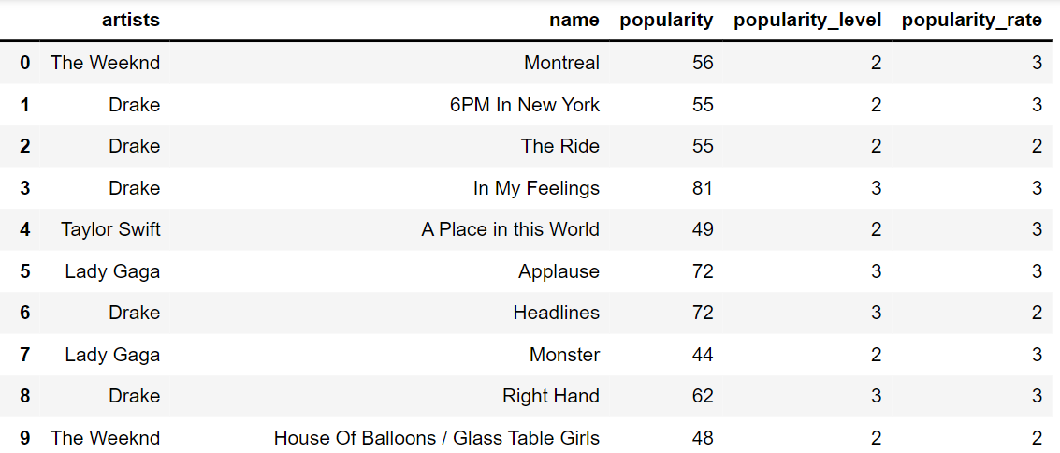
POPULARITY PREDICTIONS RESULTS
Algorithm | Accuracy
Decision Tree | 0.745427
Nearest Neighbors Classifier | 0.79367
Logistic Regression | 0.575765
AdaBoost Classifier | 0.77481
Random Forest | 0.807188
SVM | 0.7954821
External Factors
Global trends
Marketing
Big record labels
Money and promotion

Slide 12
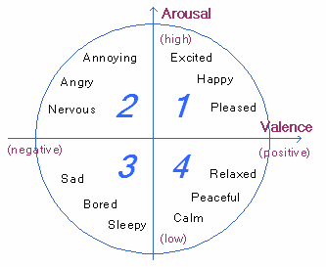

mood PREDICTION
Classifying Moods using K-Means Clustering
K-Means Clustering
The main objective of the K-Means algorithm is to minimize the sum of distances between the points and their respective cluster centroid.
With everything gathered into a neat dataset, the next step was to “cluster” the songs into different groups based on their similarities in mood.

Slide 13
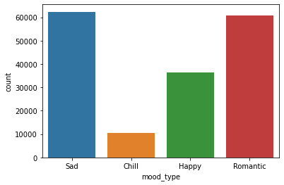
mood PREDICTION
Classifying Moods using K-Means Clustering
The chosen group containing values for danceability, energy, loudness, acousticness, and valence.
Cluster 0: “Happy”
Cluster 1: “Romantic”
Cluster 2: “Chill”
Cluster 3: “Sad”
Counter of each mood type

Slide 14
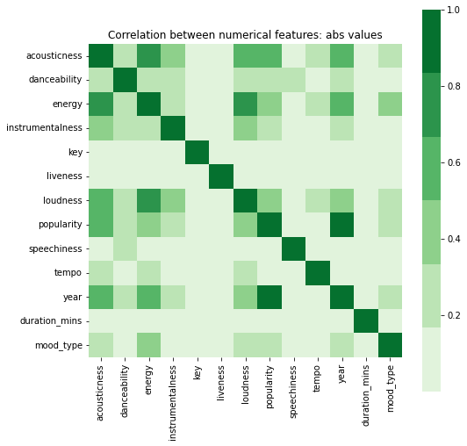
EDA – mood PREDICTION
At the beginning of the data analysis, we checked the correlations
MATRIX CORRELATION

Slide 15
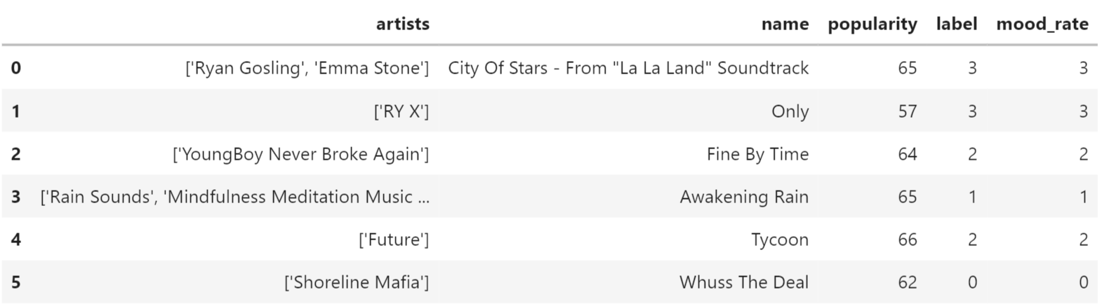
POPULARITY PREDICTIONS RESULTS
Algorithm | Accuracy
Decision Tree | 0.999129
Nearest Neighbors Classifier | 0.996422
Logistic Regression | 0.956589
AdaBoost Classifier | 0.933071
Random Forest | 0.999459
SVM | 0.998705

Slide 16
Summary
RESULTS
Popularity best prediction model is Random Forest with 0.807188
Mood best prediction model is Random Forest with 0.999459
NOTES
Data processing was performed on a dataset before use
CHALLENGES
Deciding which model, we should use
Divide the popularity into levels
Understanding the need for K-Means clustering
SOURCES
Mood ring – medium.com
Kaggle Dataset

Slide 17



Thank you
Click on the icons (link for the code and the GitHub project)
Project by
GITHUB
Popularity Prediction
Mood
Prediction
Dor Azaria
Egor Kononov

